Slide 1

Customer Retention
E-retail factors for customer activation and retention: A case study from Indian e-commerce customers
By: Shahnawaz Hussain

Slide 2
Workflow
Define the problem statement, Objective, Targets, Expected Improvement appropriately.
Collect the data, the more and better the data, better is Analysis.
Exploratory Data Analysis, check for the information, check for null values, different datatypes available, dealing with missing values if any, Check for outliers, Checking the statistical overview of the data.
Understand the relationship between the attributes, apply the visualization techniques to draw the relationship and what inferences are they making.
Note down the observations based on the visualization graphs we have created.
Write down the detailed data analysis and Conclusion.

Slide 3
Introduction
Customer satisfaction has emerged as one of the most important factors that guarantee the success of online store; it has been posited as a key stimulant of purchase, repurchase intentions and customer loyalty.
A comprehensive review of the literature, theories and models have been carried out to propose the models for customer activation and customer retention.
The research furthermore investigated the factors that influence the online customers repeat purchase intention. The combination of both utilitarian value and hedonistic values are needed to affect the repeat purchase intention (loyalty) positively.

Slide 4
Objectives
1. What is customer retention? Why is it important?
2. What is the data about and what it represents?
3. What are the Business Problems.
4. How can we improve customer retention, and increase customer engagements
5. How are we going to achieve the target at end of the project.
6. Conclusion.

Slide 5





Five Major Factors
Five major factors that contributed to the success of an e-commerce store have been identified as:
Service quality System quality Information quality Trust Net benefit

Slide 6
What is customer retention ? Why is it important ?
Customer retention refers to the ability of a company or product to retain its customers over some specified period. High customer retention means customers of the product or business tend to return to, continue to buy or in some other way not defect to another product or business, or to non-use entirely.
Customer retention increases the customers' lifetime value and boosts the company revenue. It also helps building amazing relationships with customers. customer retention often is faster and, on average, costs up to seven times less than customer acquisition.

Slide 7
What is the data about ? what it represents ?
The data is collected from the Indian online shoppers. Results indicate the e-retail success factors, which are very much critical for customer satisfaction.
The data represents Key Performance Indicators of the Indian Online business which can be analyzed and make inferences on the key findings of data.
The dataset consist of many attributes which represents customer details, behavior, e-commerce customer services details and feedback columns.
The data is provided from Fliprobo technologies in excel format which has 2 sheets,
One is detailed overview of all columns another coded file.

Slide 8
Importing Libraries
To start with, we import all the necessary libraries required in performing all the steps of data analysis. We have imported the following libraries
NumPy, Pandas :
NumPy is a library for Python that adds support for large, multi-dimensional arrays and matrices, along with a large collection of high-level mathematical functions to operate on these arrays. Pandas is a high-level data manipulation tool that is built on the NumPy package.
Matplotlib.pyplot, Seaborn:
Matplotlib is a plotting library for the Python programming language and its numerical mathematics extension NumPy.
Seaborn is a Python data visualization library based on matplotlib which provides a high-level interface for drawing attractive and informative statistical graphics.

Slide 9
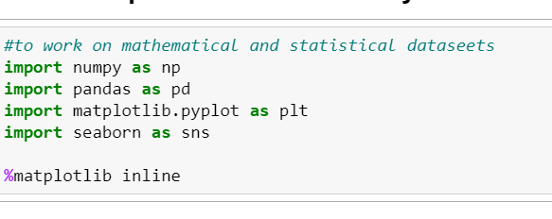
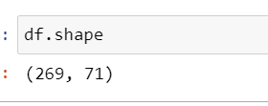
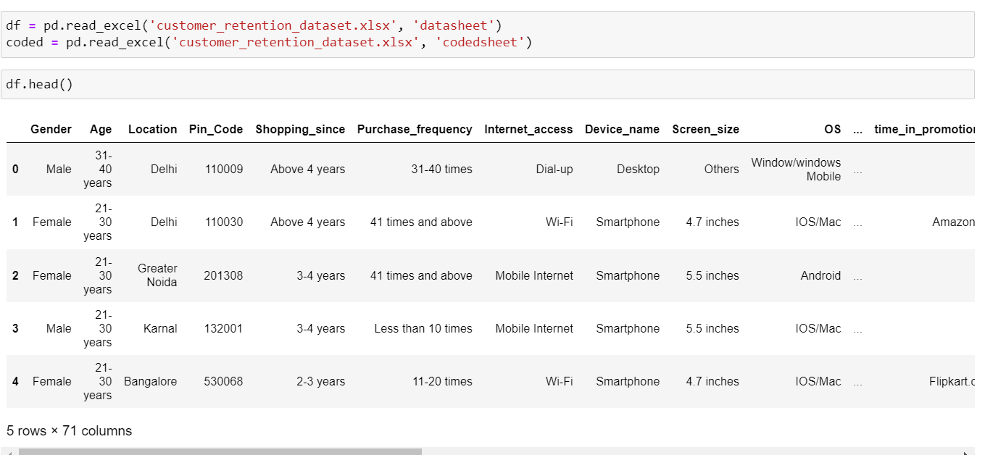
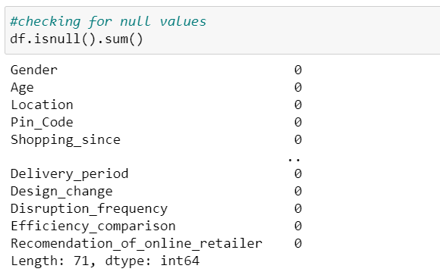
We have imported the datasets using pandas and converted them into DataFrame
Checking for top 5 columns, the shape of DataFrame and check for the null values.

Slide 10
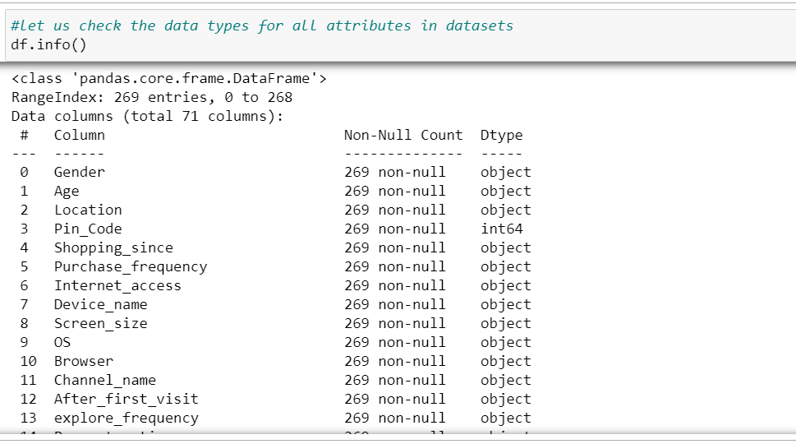
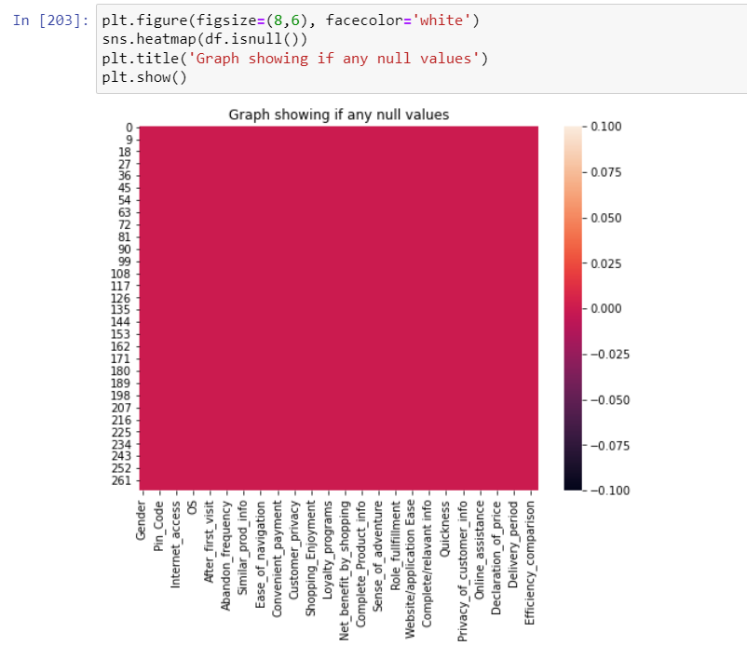
Exploratory Data Analysis
Check for the information of data, i.e., how many datatypes are present in the data, if any null values, number of entries in the dataset.
If there are any numerical values, we would have had a brief overview of statistics of dataset which helps in data analysis.

Slide 11
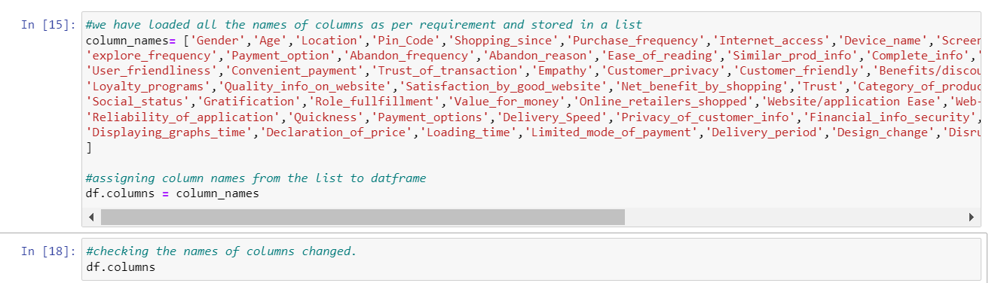
We will rename the columns into convenient and relatable names, which helps in saving the size of columns. We have renamed the columns and they are as follows.
Index(['Gender', 'Age', 'Location', 'Pin_Code', 'Shopping_since', 'Purchase_frequency', 'Internet_access', 'Device_name', 'Screen_size', 'OS', 'Browser', 'Channel_name', 'After_first_visit', 'explore_frequency', 'Payment_option', 'Abandon_frequency', 'Abandon_reason', 'Ease_of_reading', 'Similar_prod_info', 'Complete_info', 'Clear_Relavant_info', 'Ease_of_navigation', 'Loading_speed', 'User_friendliness', 'Conveient_payment', 'Trust_of_transaction', 'Empathy', 'Customer_privacy', 'Customer_friendly', 'Benefits/discounts', 'Shopping_Enjoyment', 'Convenience/flexibility', 'Return/Replacement', 'Loyalty_programs', 'Quality_info_on_website', 'Satisfaction_by_good_website', 'Net_benefit_by_shopping', 'Trust', 'Category_of_products', 'Complete_Product_info', 'Savings', 'Patronizing_retailer', 'Sense_of_adventure', 'Social_status', 'Gratification', 'Role_fullfillment', 'Value_for_money', 'Online_retailers_shopped', 'Website/application Ease', 'Web-page_layout', 'Variety_of_product', 'Complete/relavant info', 'Speed_of_website', 'Reliability_of_application', 'Quickness', 'Payment_options', 'Delivery_Speed', 'Privacy_of_customer_info', 'Financial_info_security', 'Trustworthiness', 'Online_assistance', 'time_in_promotion_sales_period', 'Displaying_graphs_time', 'Declaration_of_price', 'Loading_time', 'Limited_mode_of_payment', 'Delivery_period', 'Design_change', 'Disruption_frequency', 'Efficiency_comparison', 'Recomendation_of_online_retailer'],
dtype='object')

Slide 12
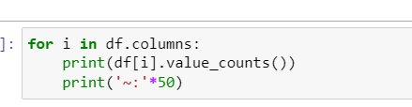
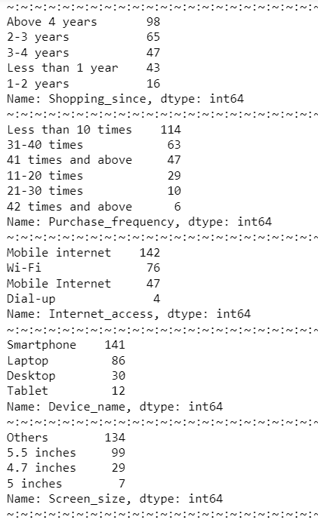
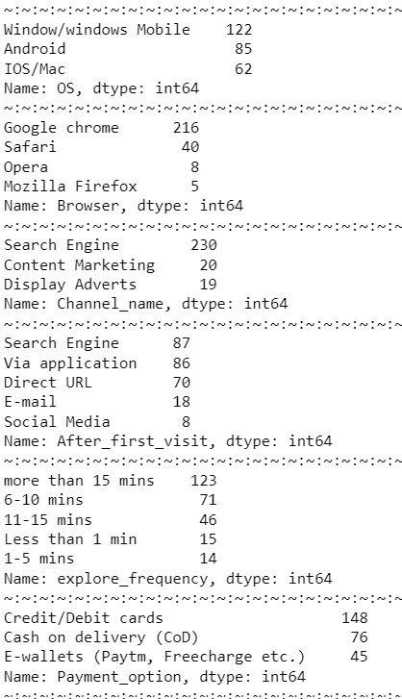
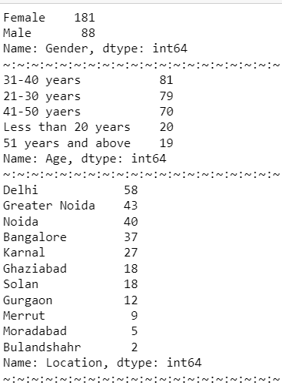
We check for unique values in all the columns in the data set using following code:
And the output as follows

Slide 13
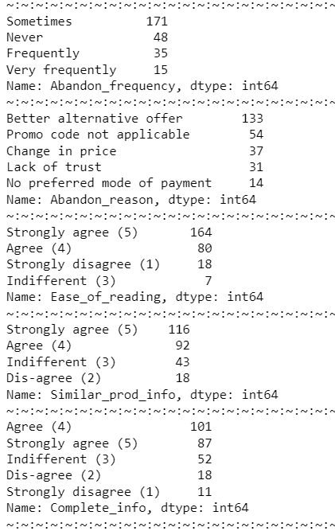
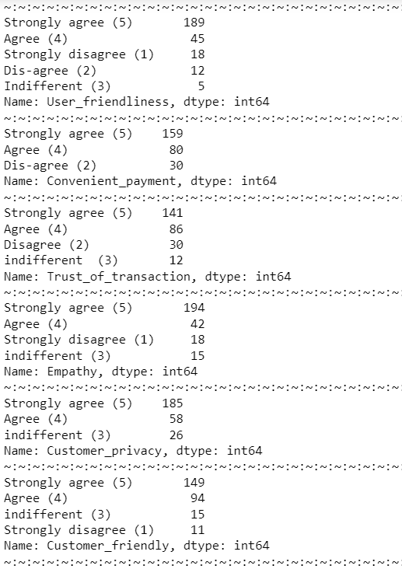
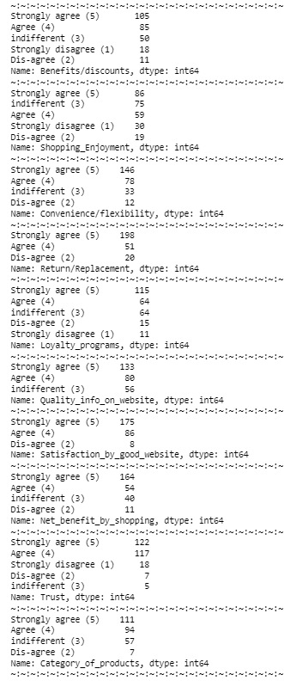
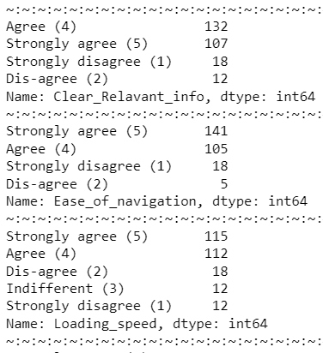

Slide 14
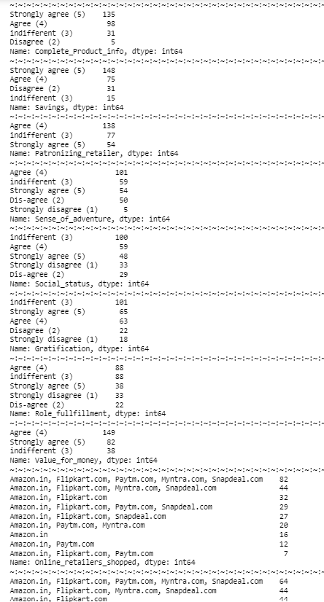
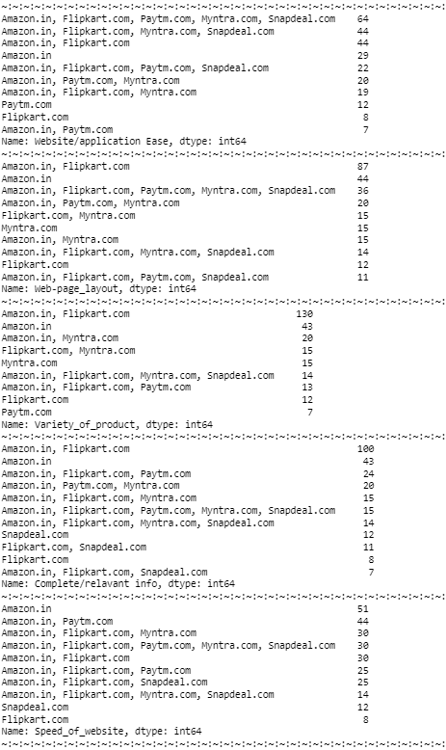
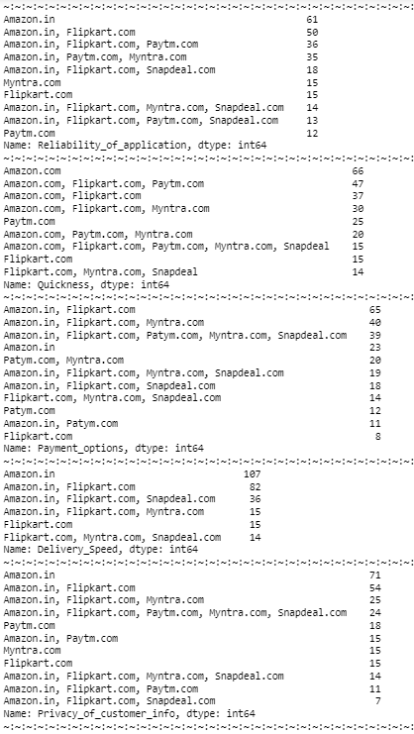

Slide 15
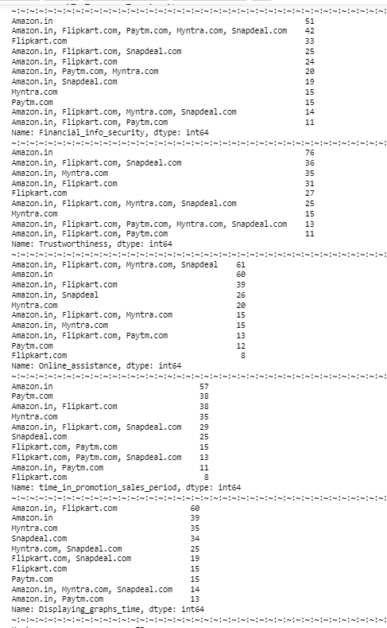
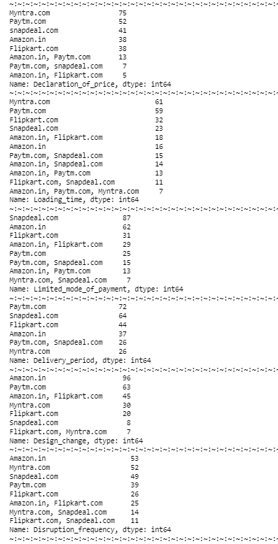
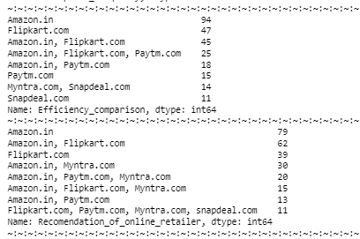

Slide 16
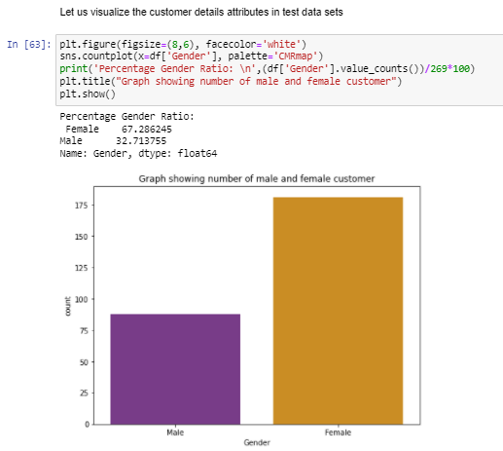
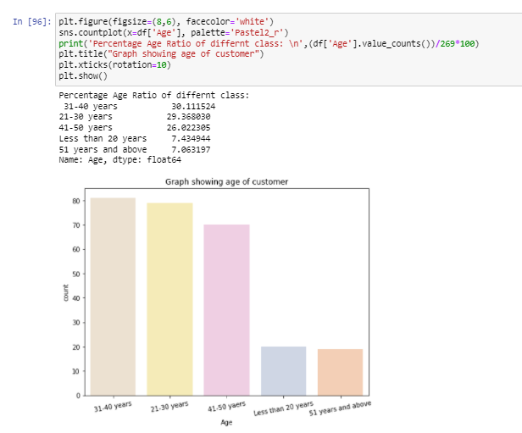
Data Visualization
1. The number of women customer shopping online is higher than that of men, 68% of customer are Women.
2. Nearly 31-40 aged people are seen to be shopping online the most. People aging from 21-50 makes around 85% of total customers who are shopping online.

Slide 17
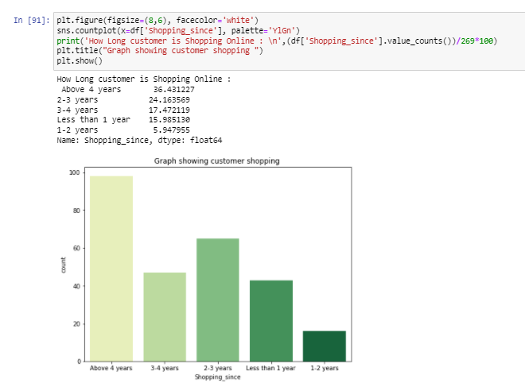
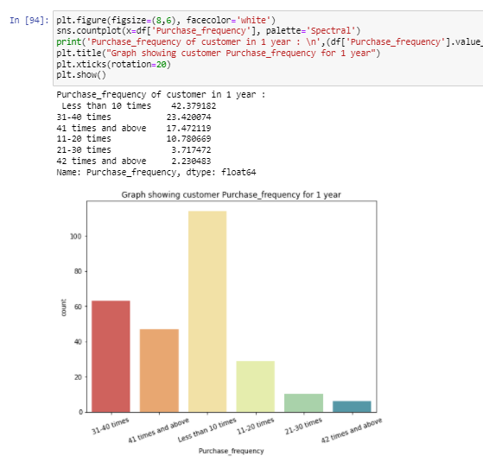
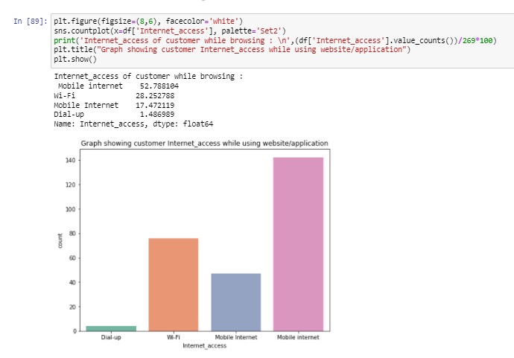
1. People shopping since 4 years make nearly 36-40% of customers, and customer shopping 80% of total customer are shopping since more than 2 years.
2. High number of people have voted to shop less than 10 times in a year. Hence this category of data need to be focused more in order to improve action and retention.
3. 70% of people using the application make use of Mobile Internet to shop online.

Slide 18
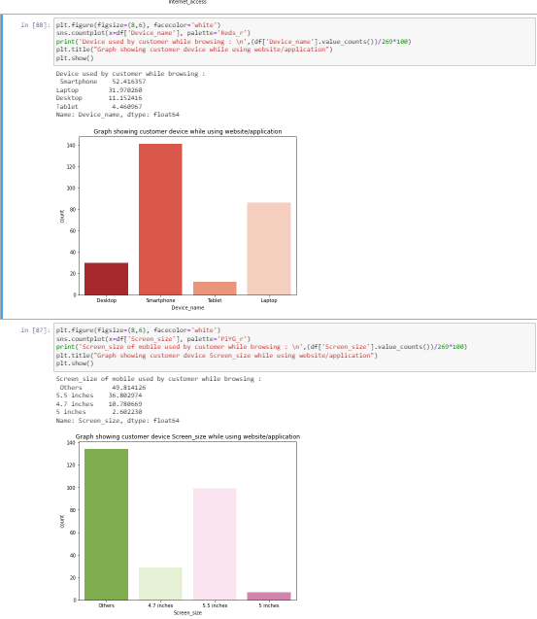
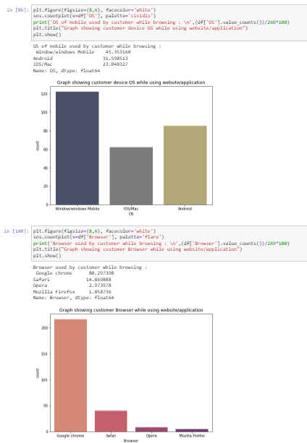
1. Customer shopping from mobile comprise of more than 50% of total customers.
80% percent customer accessing online shopping website are Chrome users. We can say that chrome provides user friendly interface which is liked by most of users.
2. Channel followed by user to arrive at the favorite online store for the first time is Search_engine
3. 45% customer uses smart phones to access online shopping and 42% customers use windows OS.

Slide 19
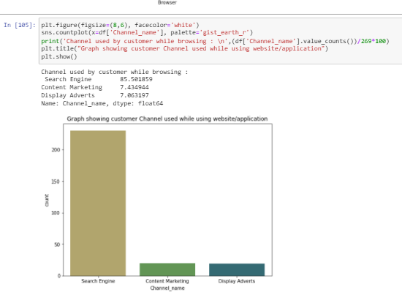
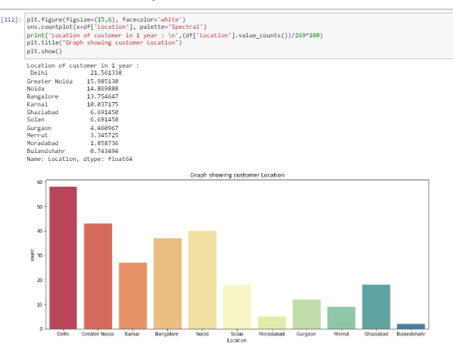
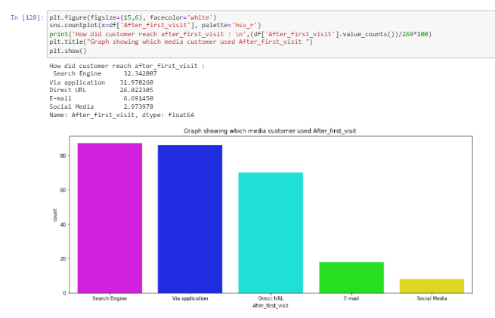
Channel followed by user to arrive at the favorite online store for the first time is Search_engine.
Highest online shopping is done from Delhi region with 21% of total customes, followed by Greater Noida, and Least is Bulandshahr.
90% of Customer has reached the websites after first visit through search engine, application and company URL.

Slide 20
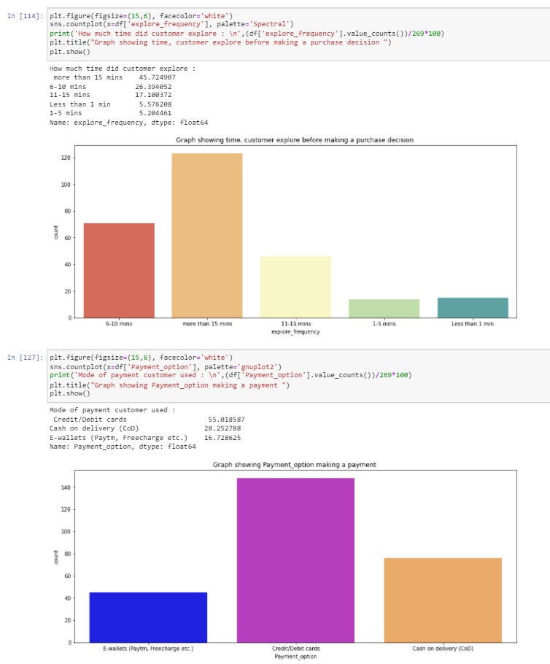
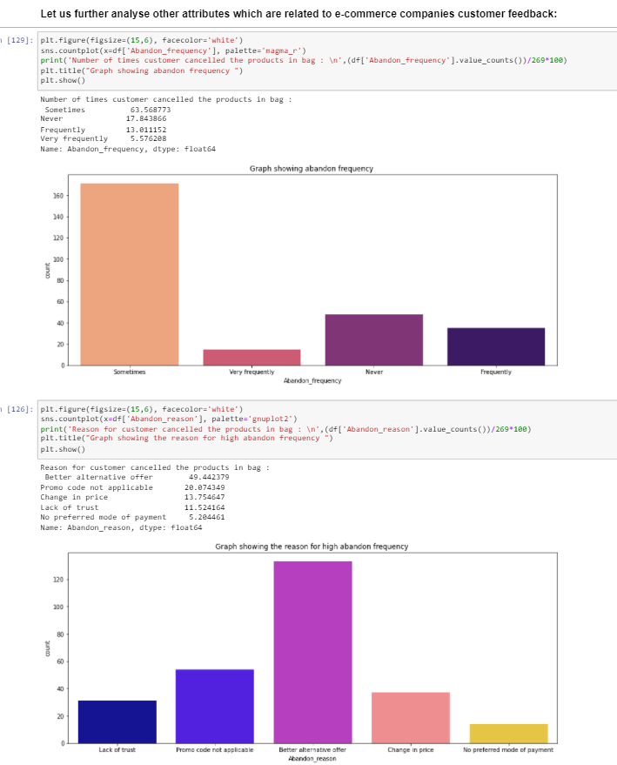
1. Most of the customer has spent more than 15 minutes before making the decision of purchase.
2. Customre feels ease of using Debit/Credit cards and COD as mode of payment while making an order. This may be due to availability of any cashback offers or customer see reliabilty in COD payment.
3. 65% of Customers have voted that they abandon the products in bags "Sometimes".
4. More than 50 % of customer has abandoned the bag as they got another alternative, but nearly 30% of customer abandoned due to lack of trust and not available mode of payment, by focusing on providing good benefits and multiple mode of payments may reduce these columns into 0.¶

Slide 21
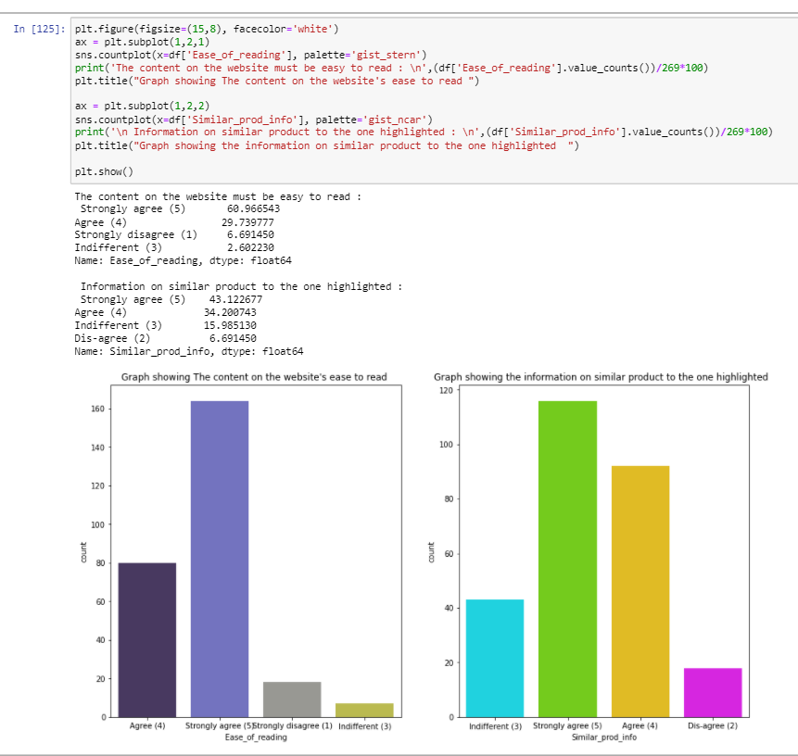
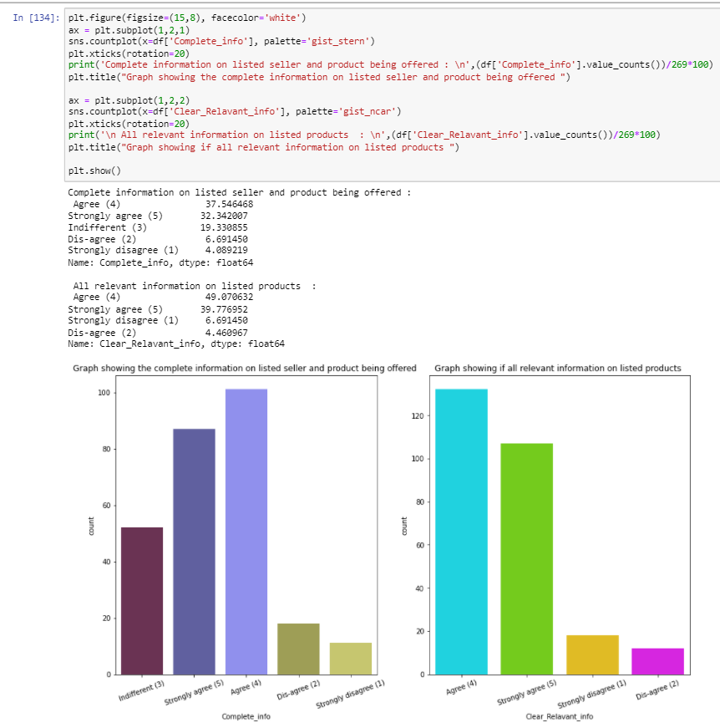
1. 90% of customer agree or Strongly agree that the content on the website is be easy to read and understand. Further improvement can be directly made by asking customer feedback and taking hypthesis if that decision holds good for all population.
2. 80% of customer agree that information on similar product to the one highlighted is important for product comparison.
3. 75% of customer agree that if product is to be bough by most of customer then, complete information on listed seller and product being offered is important for purchase decision.
4. 90% agree that to make a clear decision on purchase of product all the relevant information on listed products must be stated clearly

Slide 22
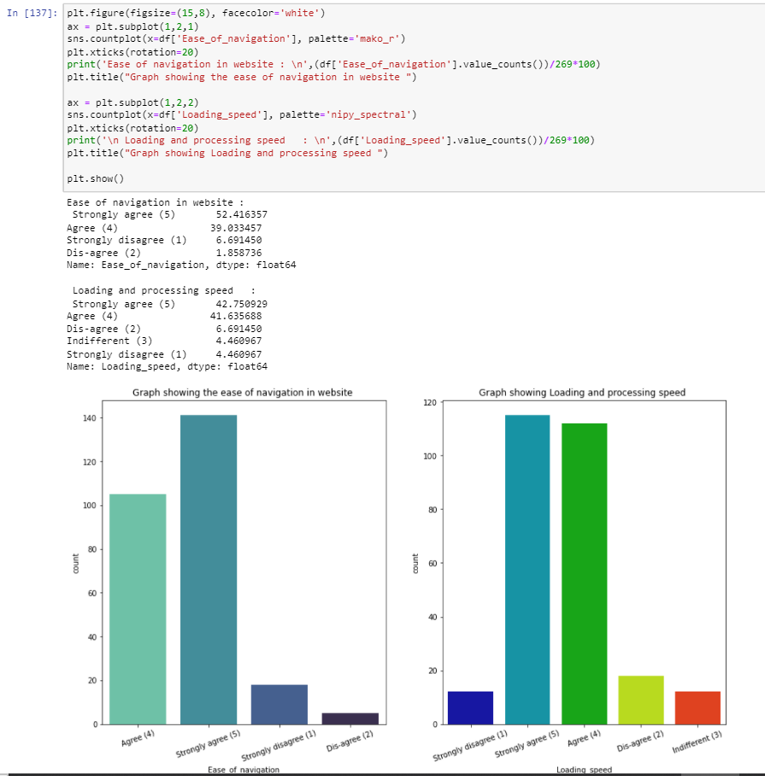
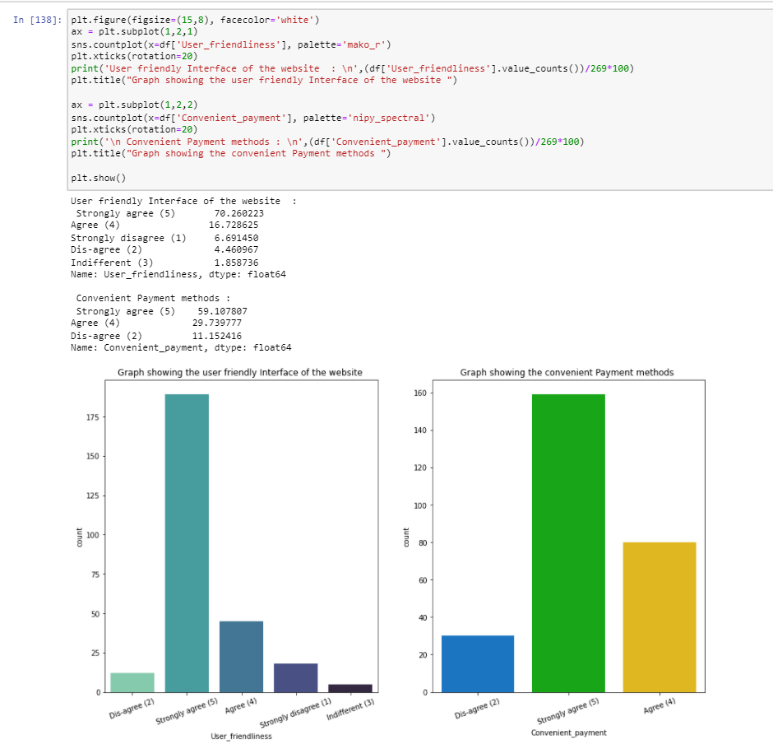
1. It is evident that companies website should have better ease of navigation in website to make more customer interaction and customer activation.
2. The website/Application should have better loading and processing speed, agreed by 85% of customers.
3. Website having user friendly Interface will have high customer interaction, strongly agreed by 70%
4. 60% of customer strongly agree that comapanies have convenient mode of payments.

Slide 23
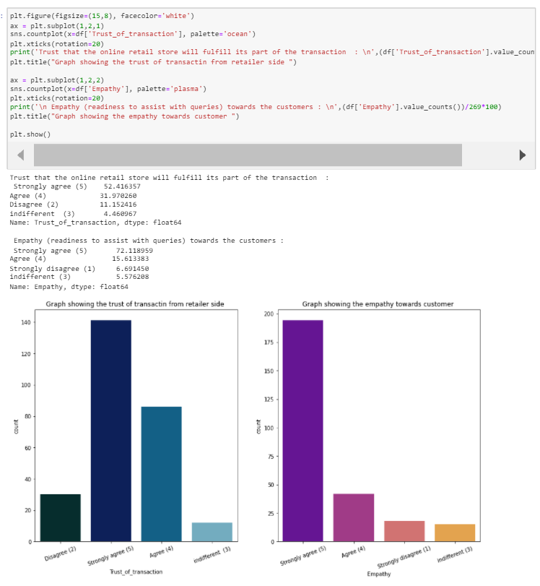
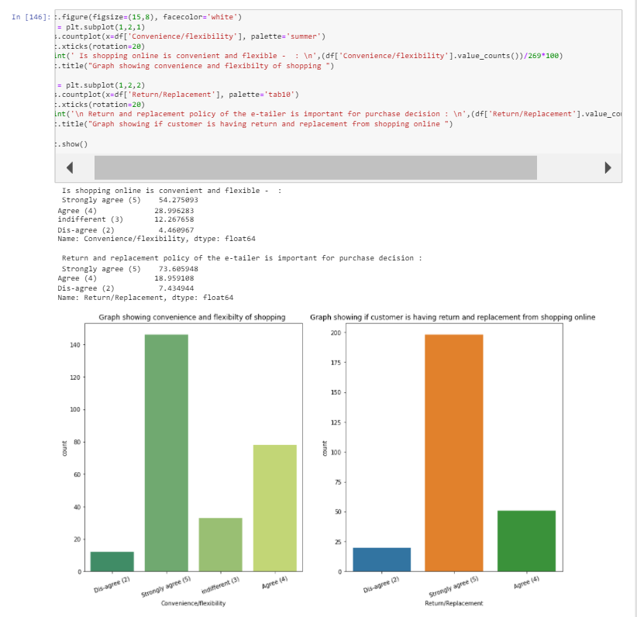
Customer have agreed that there is trust of transaction with the online retailers.
They strongly agree that customer executives have empathy towards customers problems.
3. Customer strongly agree that customer care executives behave with empathy towards customer problems/issues.
2. Customer have strongly agreed that customer data privacy is guranteed and Responsiveness is more customer friendly.

Slide 24
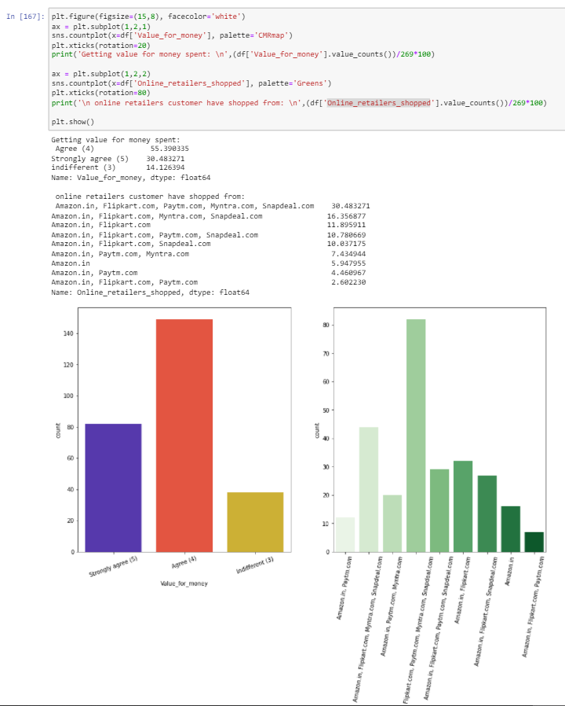
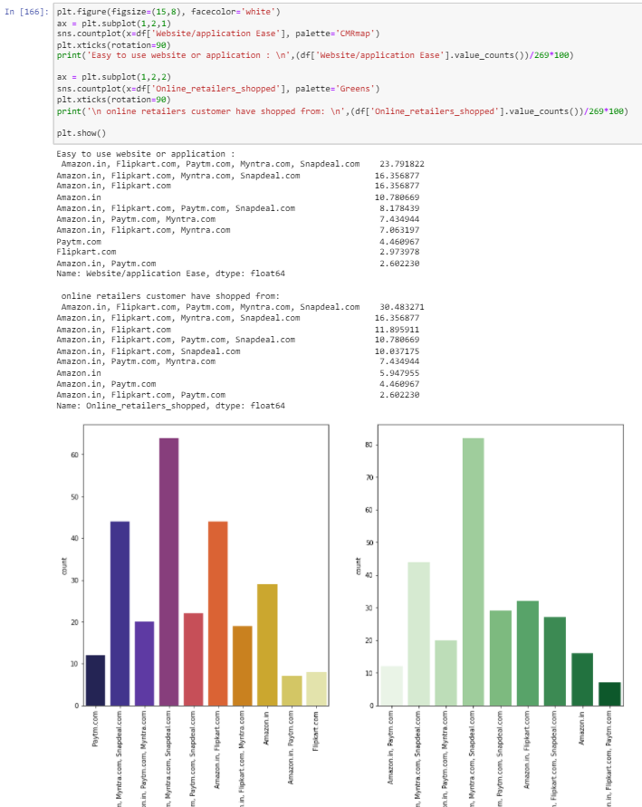

Slide 25
Customers have strongly agreed the following below points:
Benefits and Discounts are provided by online shopping retailers, and they have enjoyed the shopping experience.
Convenience and Flexibility in shopping online, Return/Replacements are provided for the products purchased.
Loyalty benefit programs are benefits for online shopping,
Information provided on website have quality information of products and improves customer satisfaction.
Net benefits by online shopping leads to customer satisfaction
Online shopping provides wide variety of products listed into websites.
There is provision for complete product information.
From online shopping the monetary savings can be done.¶

Slide 26
People agreed or have indifferent feeling on below attributes
37% customer have indifferent feeling on Gratification on e-retailer
32% of customer have indifferent feeling that shopping online fills the role.
55% customer believes that online shopping give value for money.
* Amazon being top player in the e-commerce business, is one of common Online_retailers_shopped by all customers.

Slide 27
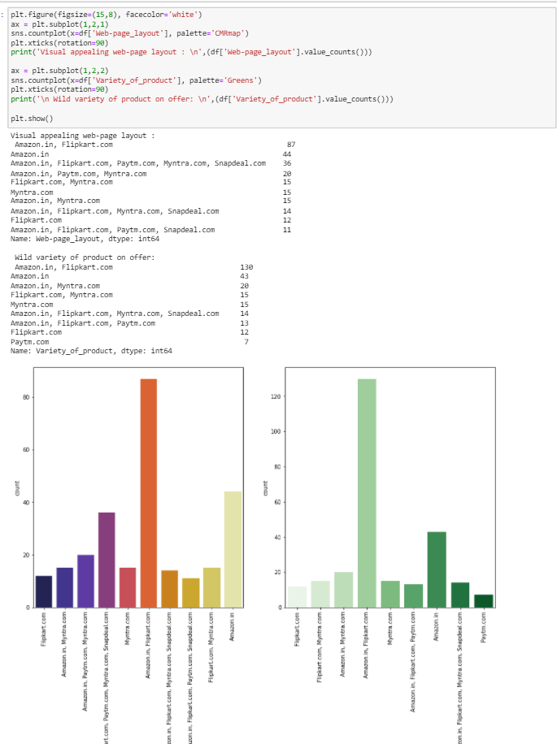
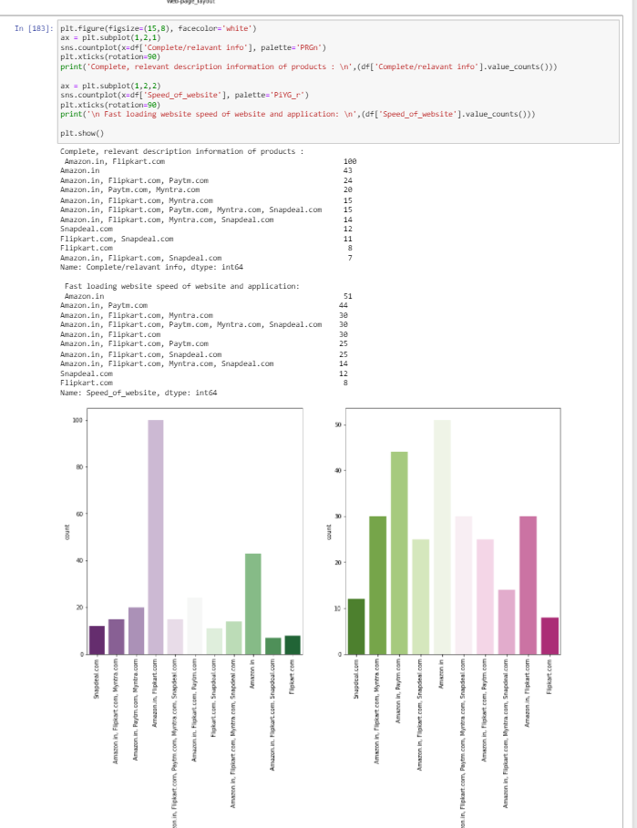
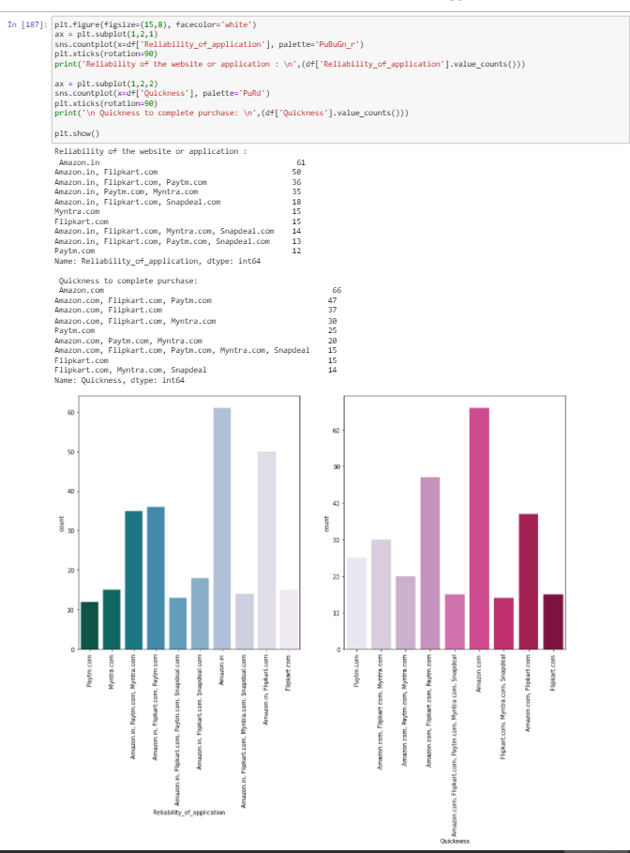

Slide 28
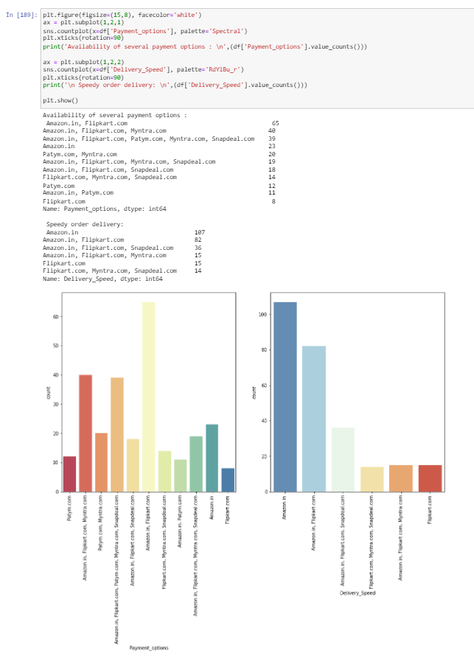

Slide 29
Observations
Amazon and Flipkart are the online shopping applications/websites with good web-page layout, comprise of 32% of customer votes
70% of customers say that wild variety of products are listed in Amazon and Flipkart
15% of customers believe the reliability of amazon website is better followed by Flipkart, Myntra, Paytm, Snapdeal
Amazon has quickest purchase time as per customer feedback comprise of 28% of total feedback
Wide range of payment methods must be provided by online websites/application in order to attract higher customer base.
In order to retain the customer, we must work more on waiting period for delivery, which can be done by appointing more logistics option internally as well as externally.¶

Slide 30
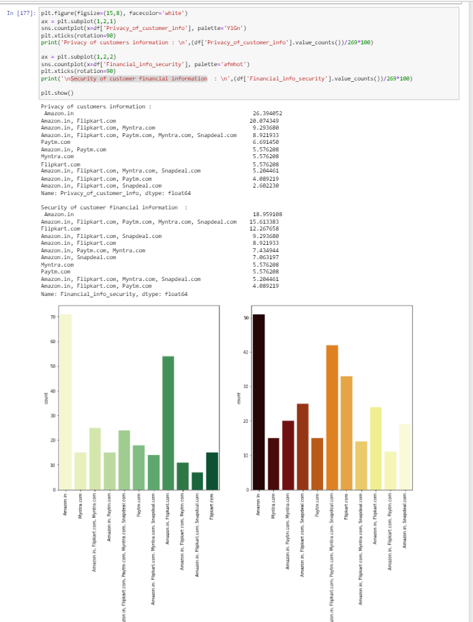
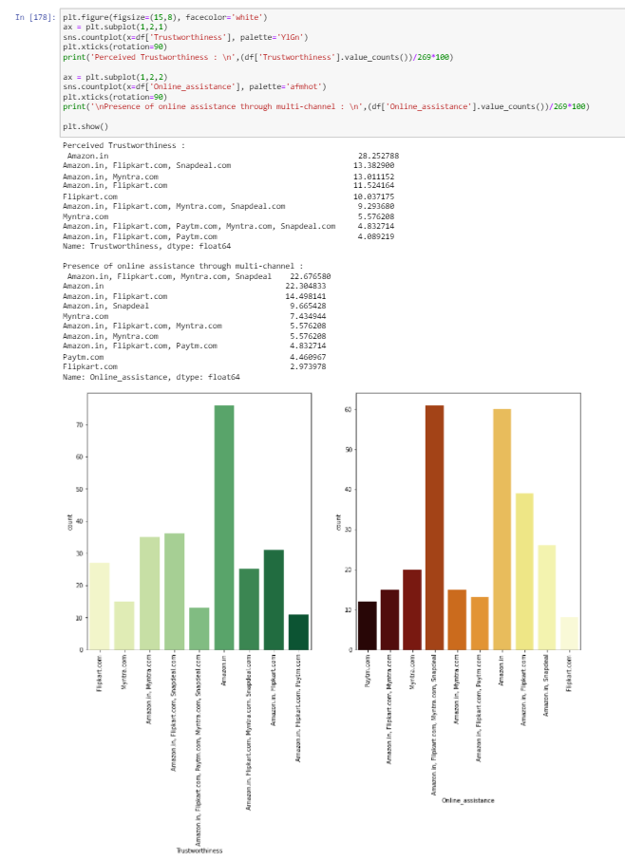
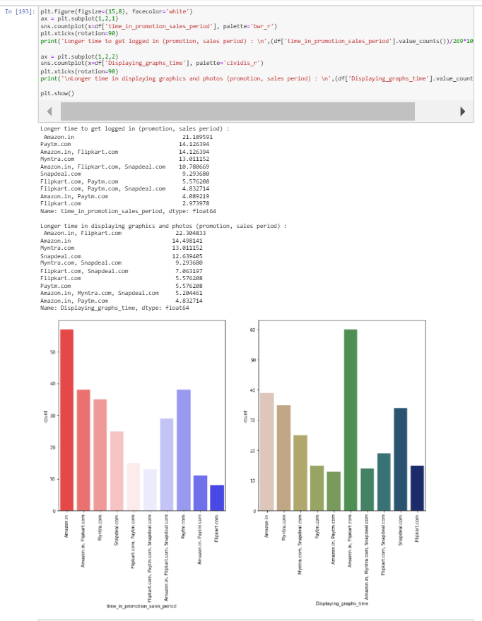

Slide 31
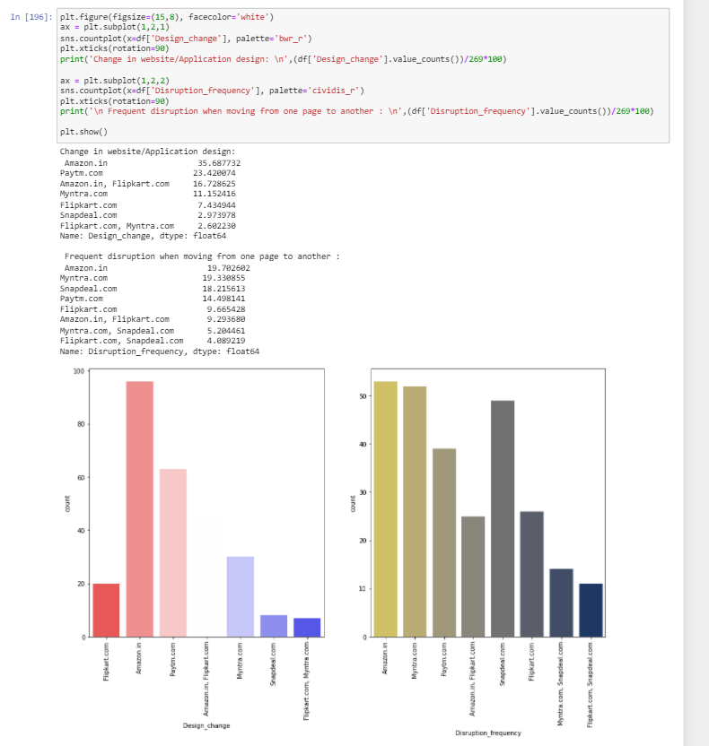
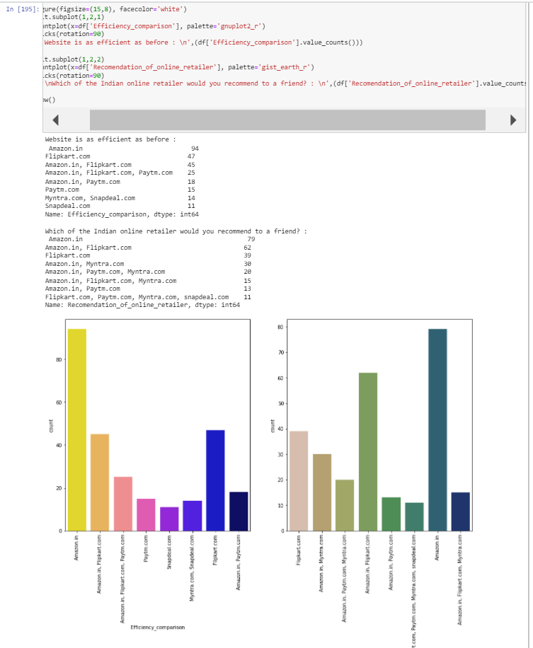

Slide 32
Observations:
Privacy of customers information: When customer uses online shopping, they will be sharing all the personal/private information to the retailers, Keeping the privacy of customer is one of toughest though most important thing which helps in building trust in customers
Financial information: shared by customer during payments will be saved in online store databases. Hence keeping the financial information safe makes the them reliable towards customer.
Trustworthiness: built up towards customer might be one of important reason to increase customer database
If customer who have made online shopping from any retailer, Resolving their issues w.r.t to product should be important to attract them again form online shopping, Presence of online assistance through multi-channel should be kept by online retailers.
To increase the number of customers attracting to online shopping, online retailers should focus on increasing sales promotion.
Online websites/applications should be having attractive product information and images/ graphics in order to make products more visible for shopping. While it should also be kept in mind to keep time constraints of loading the websites/images.
Online retailers will always be trying to bring any changes in their websites so change in website/Application design will be important to increase customer interaction.
Website/application efficiency are calculated by how fast the website can bring up the results, how big traffic it can hold with out being disrupted and how light the application is. It must be designed keeping all the constraints in mind to be more efficient.
Finally, recommendation is something one does when that product is impressive and has been outstanding with all the competitors.
We can see that amazon has got 79 individual votes out of 269, and Flipkart has got 39 votes from the customer choose.

Slide 33
Conclusion:
Based on the above understanding, analysis, EDA steps and visualizations we could see find some insights about the online retail stores, how they have been working to improvise there customer activity and increasing customer repeat purchase intention.
The gender ratio of male and female was unbalanced, there are a greater number of women who make online shopping then that of men, who are shopping since more than 3 years, most of customer use Mobile applications for online shopping using their mobile internet to connect to online retailers.
The sales of products could be increased by analyzing the reason provided to abandon the bag, by increasing the quality of information that is being provided in the product information box, providing more benefits to the customers and discounts over the period of times, customer retention can be seen, which also helps in increasing the customer Loyalty towards the online retailers.
Online retailers should be more focused providing the best service to the customer base like providing clear and much relevant information for products or setting up the good website/application service which is handy in use with user-friendly interfaces.

Slide 34
Conclusion:
Online retailers should be more focused on providing convenient mode of payments so that customer feels safe to share the private and financial information for transactions and make sure the privacy retention of customer is the goal.
E-commerce businesses must provide wild range of variety of combinations for the products which make the customer to choose which is best suitable for there use case, also make sure that products listed on the site are trustworthy and maintain quality. Customer also be provided with return and replacement policies.
Overall customer should be provided with such a service that he is coming back to us with all heart looking for the value for the money he spent on our products, such services create trustworthiness between customer and sellers.
Looking at above surveys took between couple of the online retailers, Amazon has been the best customer friendly, reliable, user friendly, customer service focused company which has excellent customer assistance at hand to provide all the information, help needed by customer hence such environments attract huge customer bases, and a smaller number of churns are seen.
By the recommendations provided Amazon bagged 21% of overall upvotes which makes that amazon is leading in its own sector. Though there are some drawbacks like 'mode of payments' and 'Speed_of_website', 'website application ease' which company needs to work on to improvise near actions and attract more customers.
Likewise, company has been constantly focusing on providing customer benefits and discounts on products to attract huge base of customer.

Slide 35
Thank You ☺

